Slide 1
tmdb /’ti’ɛm’di’bi/ n. 1. A community-built movie and TV database with an accompanying API.

Slide 2

a Python apart

Slide 3
and
excel films
production

Slide 4
a Presentation by Alexander Wright

Slide 5

THE
MOVIE
DATA
BREAKDOWN
SAMUEL L.
JSON
BRAD
PIVOT
A Mission to Produce the Next Blockbuster
The 4,000 Highest Rated Films…
AND
JAMMIE BOXX (and whisker)
Starring

Slide 6
Once Upon a Time
in Hollywood
…

Slide 7

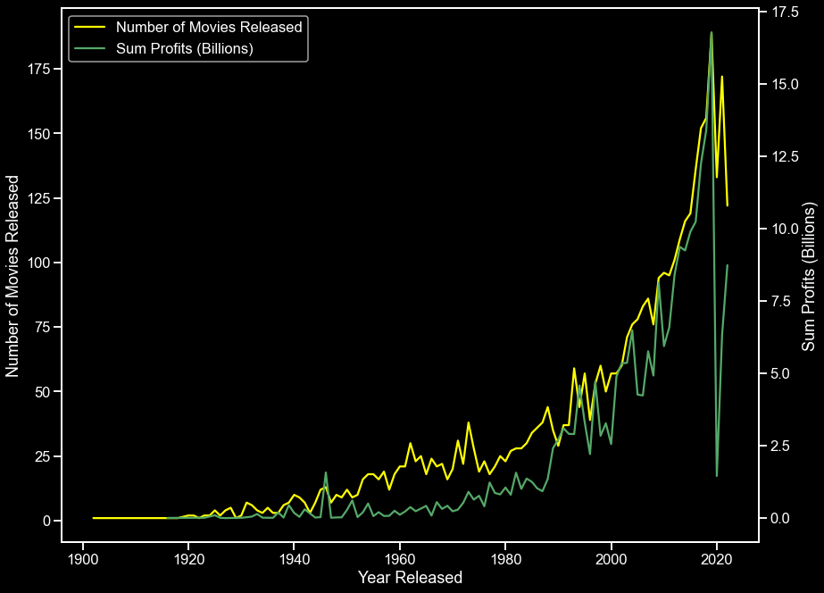
Movies Releases and Profits Over Time

Slide 8
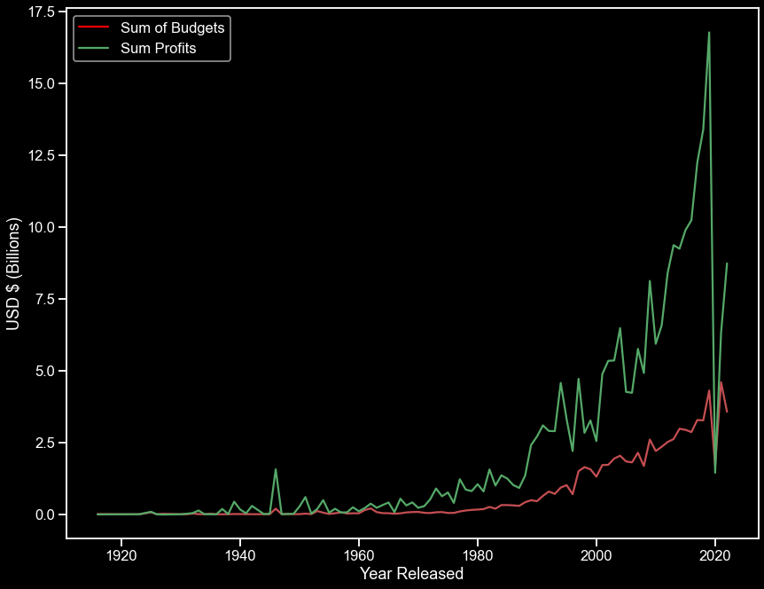
Budget and Profit Over Time

Slide 9
Before COVID Movies were at an all time high in terms of
frequency and profit.
Average Budget: 18.5 Million
Average Profit: 56 Million
Average Return Ratio: 3:1 Million

Slide 10
Chapter One
BLING-BLING

Slide 11
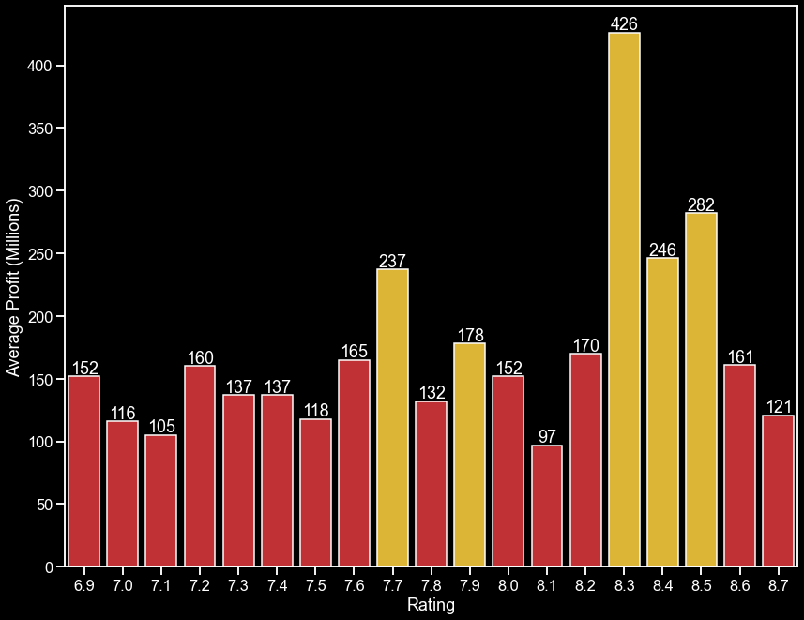
Average Profit By Movie Rating

Slide 12
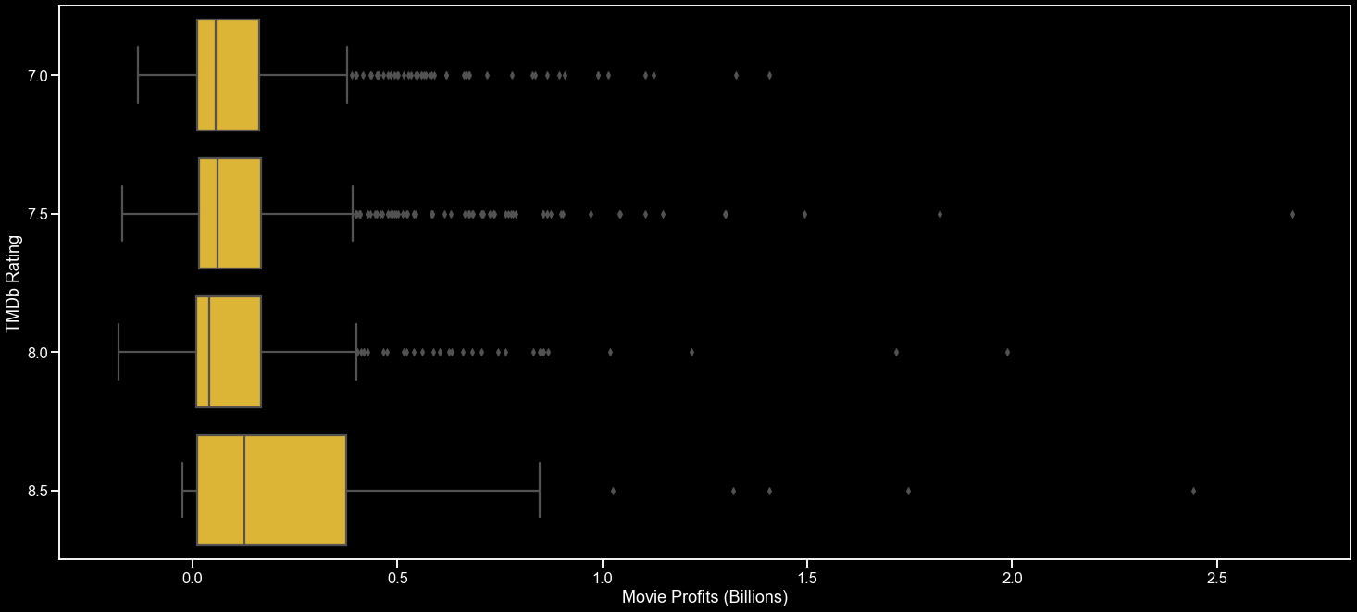
Movie Profits
By TMDb Rating

Slide 13
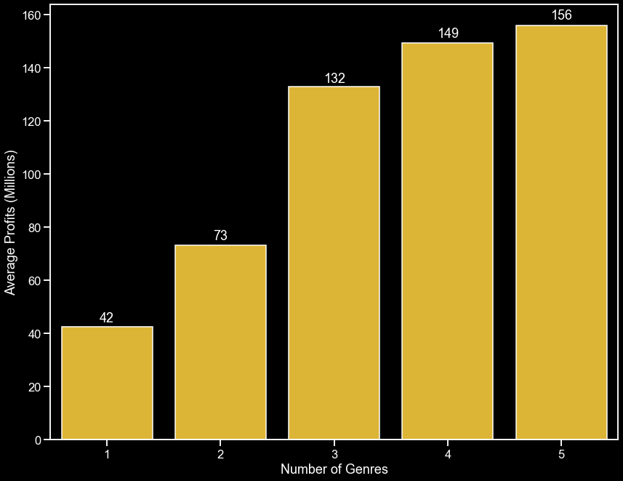
Average Profit By Genre Count

Slide 14
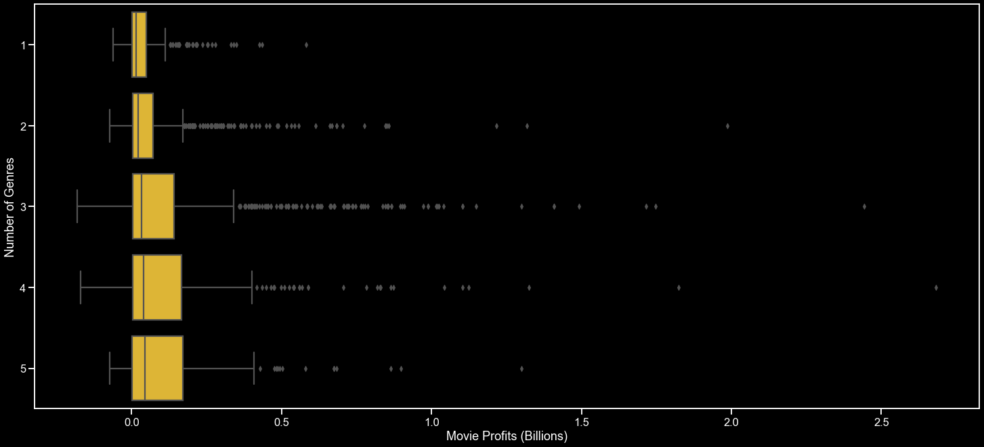
Movie Profits
By Genre Count

Slide 15
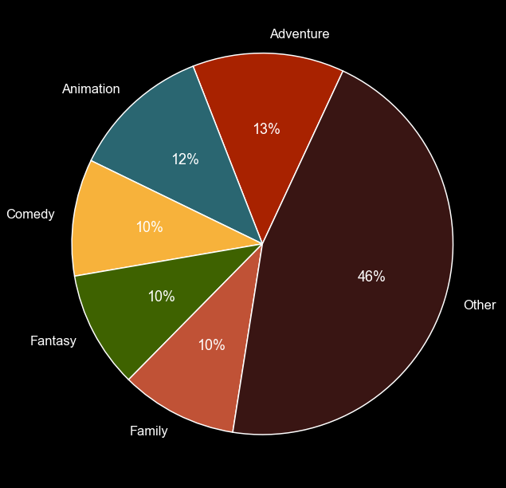
Proportion of Genres in 5 Genre Movies

Slide 16
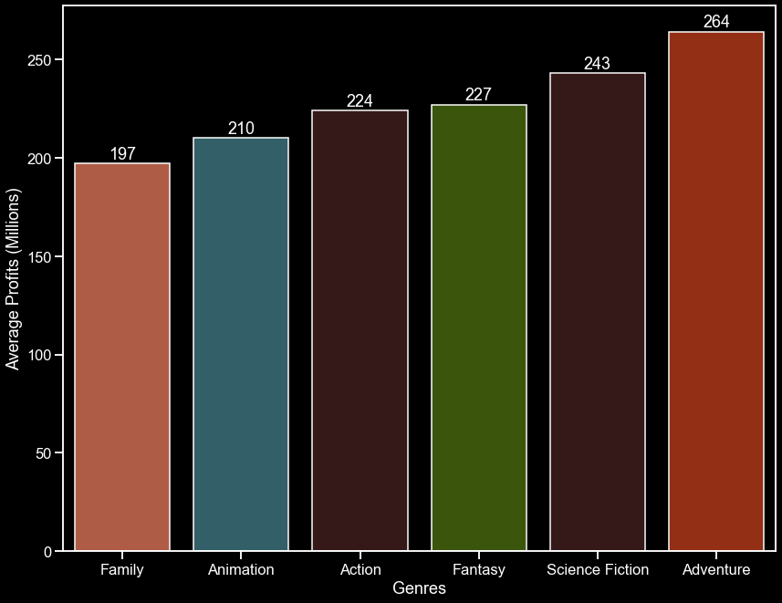
Average Profit By Genre Type

Slide 17
Animated Films are high-risk, high-reward.
Boasting some of the highest budgets in
the industry, but also the biggest returns.
Average Animation Budget: 59 Million
Average Animation Profit: 135 Million
Average Animation Return Ratio: 4:1 Million

Slide 18
If we maintain the goal of releasing the
next animated block buster, we should form a
cast and crew that maximizes our chances
of success.

Slide 19
Chapter Two
INGLORIOUS FILM-MAKERS

Slide 20
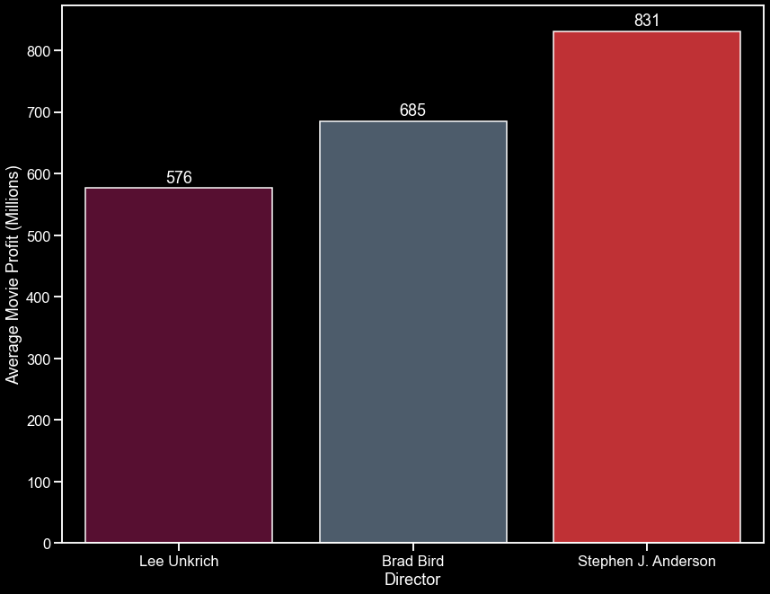
Top 3 Animated Film Directors Based on Average Profit

Slide 21
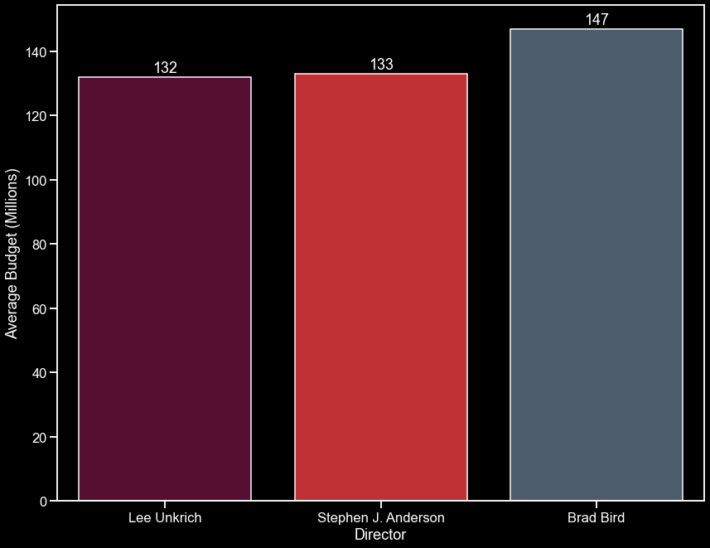
Average Budget for Selected Movie Directors

Slide 22


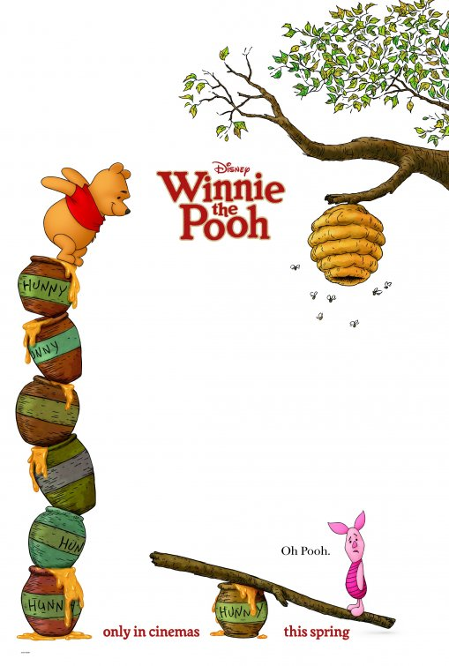


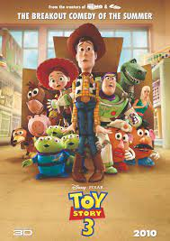



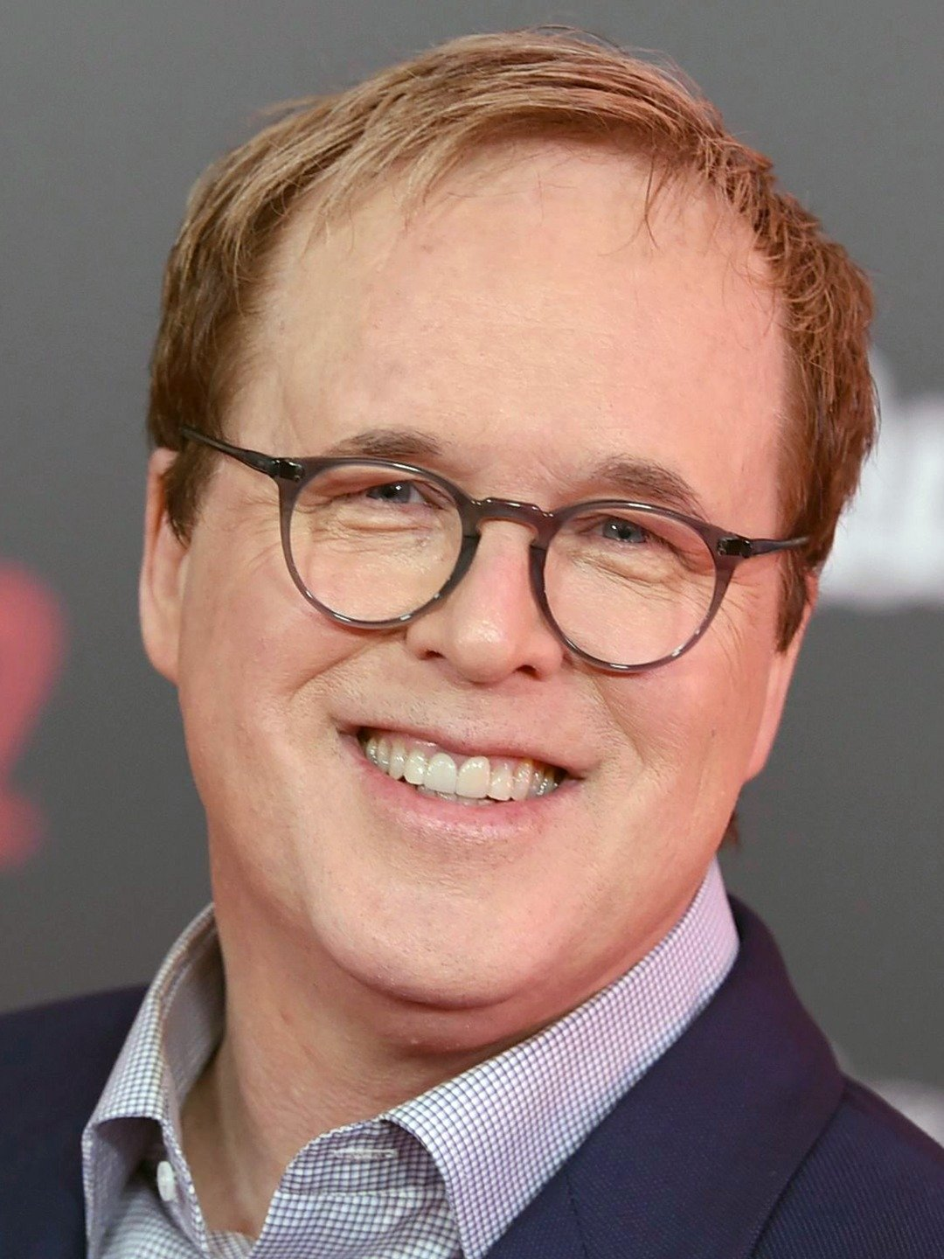




Stephen J. Anderson Ratio 6.2:1
Lee Unkrich Ratio 4.4:1
Co-Directed
Brad Bird Ratio 4.7:1

Slide 23
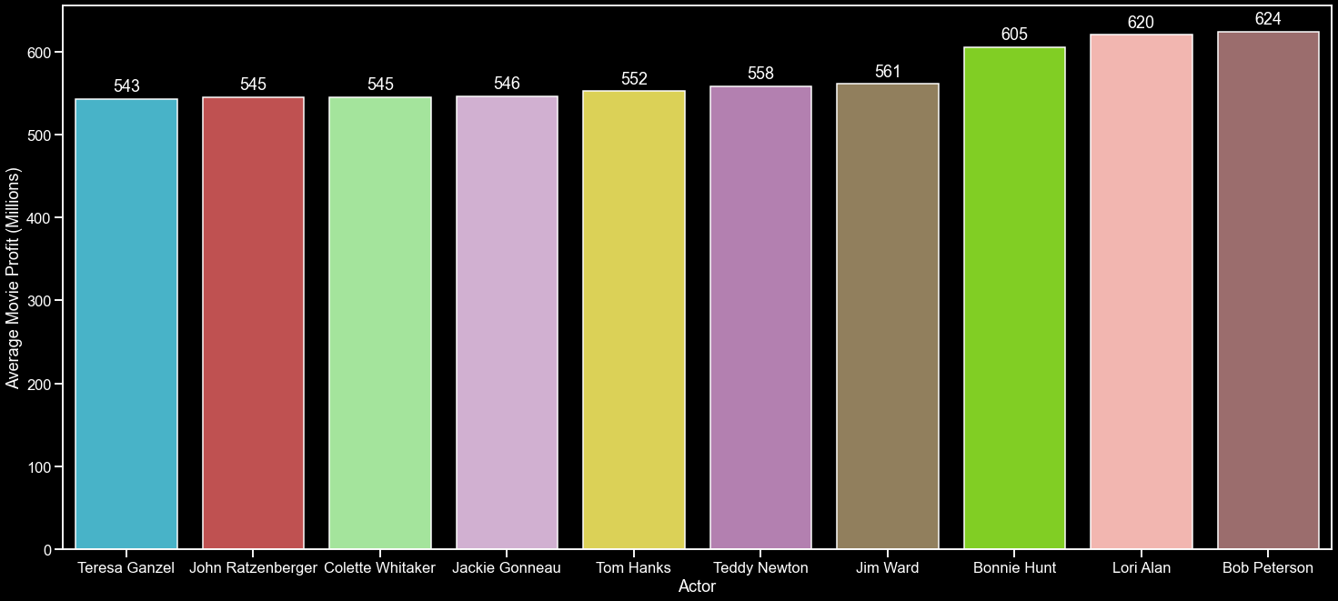
Top 10 Actors Based on Average Profit

Slide 24
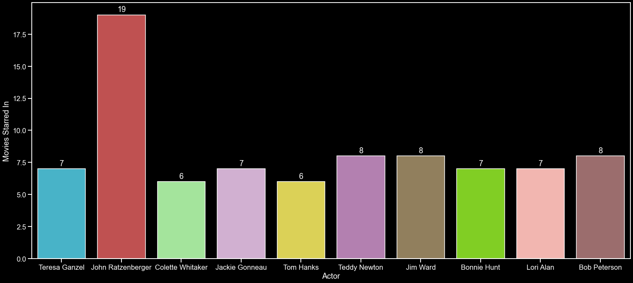
Number of Animated Films Selected Actors Have Starred In

Slide 25





Potential Leads
Tom Hanks
Bonnie Hunt
Also Starring
Bob Peterson
Jackie Gonneau
Colette Whitaker

Slide 26
With our potential cast and crew
identified, it’s time to pinpoint a release
window that can maximize our gains.
Estimated Budget: 139.5 Million
Estimated Profit:
630 Million

Slide 27
Chapter Three
LET’S ALL GO TO THE MOVIES

Slide 28
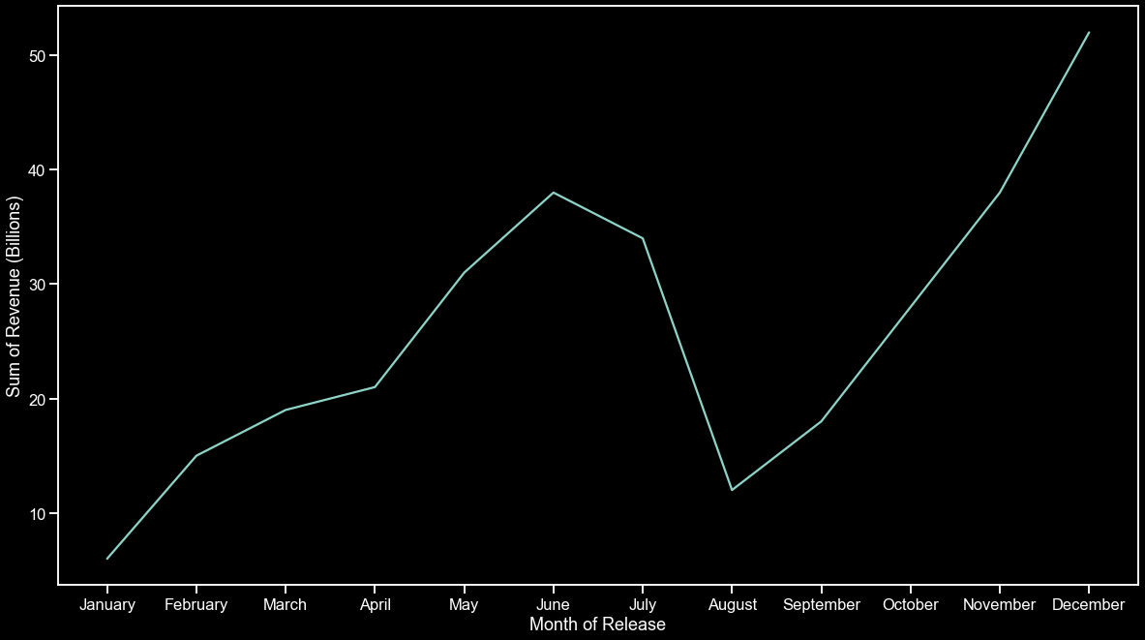
Sum of Revenue By Month Over a +100 Year Period

Slide 29
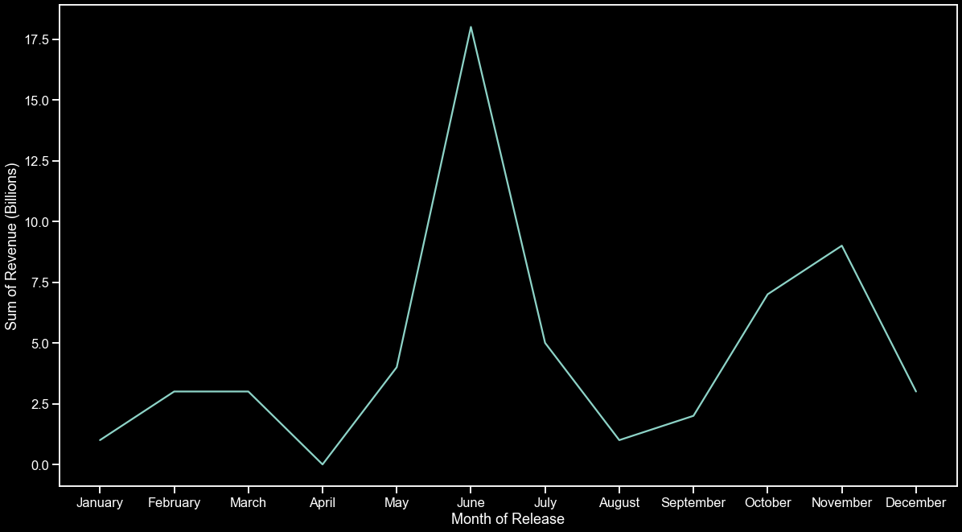
Sum of Animated Films Revenue By Month Over a +100 Year Period

Slide 30
Movies over the past +100 years have done
extremely well when releasing in the
months of June and December, favoring
Late Autumn/Early Winer.
However, Animated films do the best in
June, so that’s our ideal release window.

Slide 31
EPILOGUE
BLOCK BUSTED

Slide 32
Our Finalized Movie Formula
Blockbuster
=
Genres:
Animation
Adventure
Family
Comedy
Crew:
Cast:
Details:
Director – Brad Bird
Lead – Tom Hanks
Release in June
Co-Director – Lee Unkrich
Lead – Bonnie Hunt
TMDb score: 8.3
Support – Bob Peterson
Support – Jackie Gonneau
Support – Colette Whitaker

Slide 33
Fin .

